Slide 1
Couch Critics The best place to find the latest movies and tv shows reviews
Adriano Costa, Guilherme Santos e Nuno Pinho
Interação Humano Computador
Turma P5

Slide 2
Table of contents
01
02
03
04
05
06
Introduction
Personas and Tasks
Requirements
Low Fidelity Prototype
Functional Prototype
Conclusion

Slide 3
01
Introduction

Slide 4
Context
Couch Critics is a web platform that allows users to check the opinions of people on the world of entertainment.
The users can express their opinion through the publish of reviews about their favorite Movies and Tv Shows, rating them on a scale from 0-10.
As well as maintaining a history of self-published reviews.

Slide 5
Process
Define Scenarios and Tasks
LFP
01
02
03
04
05
Create Personas
Extract
Requirements
HFP

Slide 6
02
Personas and Tasks

Slide 7
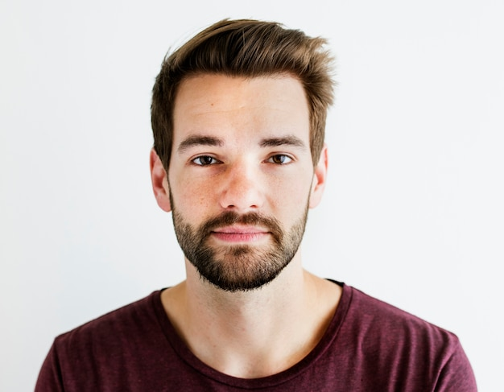
Personas
Tiago is a 25-year-old film enthusiast and aspiring filmmaker.
Growing up in the digital age, he developed a fascination for the latest trends in cinema and an appreciation for the diversity of perspectives in modern filmmaking.
Tiago's approach to reviewing is immediate, capturing his initial impressions right after watching a film, in hopes that it can influence someone to watch, or not, the movie

Slide 8

Personas
Sara is a 41-year-old woman who works as a high school teacher.
She's passionate about hosting movie/TV shows nights for her friends and family, considering it a way to bond and share experiences.
Her favorite categories are Comedy and Action.
With a busy schedule, she relies heavily on reviews to help her chose the perfect movie lineup for her gatherings.

Slide 9
Scenarios and Tasks
Scenario 1: Writing a review for a movie
After watching the latest movie "Oppenheimer" , Tiago decides to quickly open the "Couch Critics" app to write his first thoughts about the movie. He finds the movie in the app and writes a good review with 8.2/10 rating, in hopes that other people will give it a chance.
Task 1:
Publish a review of the movie “Oppenheimer” with a rating of 8.2/10.

Slide 10
Scenarios and Tasks
Scenario 2: Searching for the highest rated review in a tv show
Sara needs to find a good show to watch with her family. She doesn't have much time so decides to go to the TV shows tab and chooses the Comedy category then she sorts them by highest rating, she chooses a show with a lot of positive reviews and good rating, ending up with a great and funny entertainment session.
Task 2:
Find the highest-rated comedy TV show and check its highest-rated reviews.

Slide 11
Scenarios and Tasks
Scenario 3: Check review history
Tiago and his friend are talking about who was the first to make a review to a movie, so Tiago opens the “couch critics” app and check when his first movie review was.
Task 3:
Find the date of your first published movie review.

Slide 12
03
Requirements

Slide 13





Functional Requirements
Availability of multiple movies/tv shows;
Search Bar
Filter and Sort system
Make and publish reviews
User profile with reviews history

Slide 14



Non-functional Requirements
Store movies/tvshows
Allow different Users

Slide 15
04
Low Fidelity Prototype

Slide 16
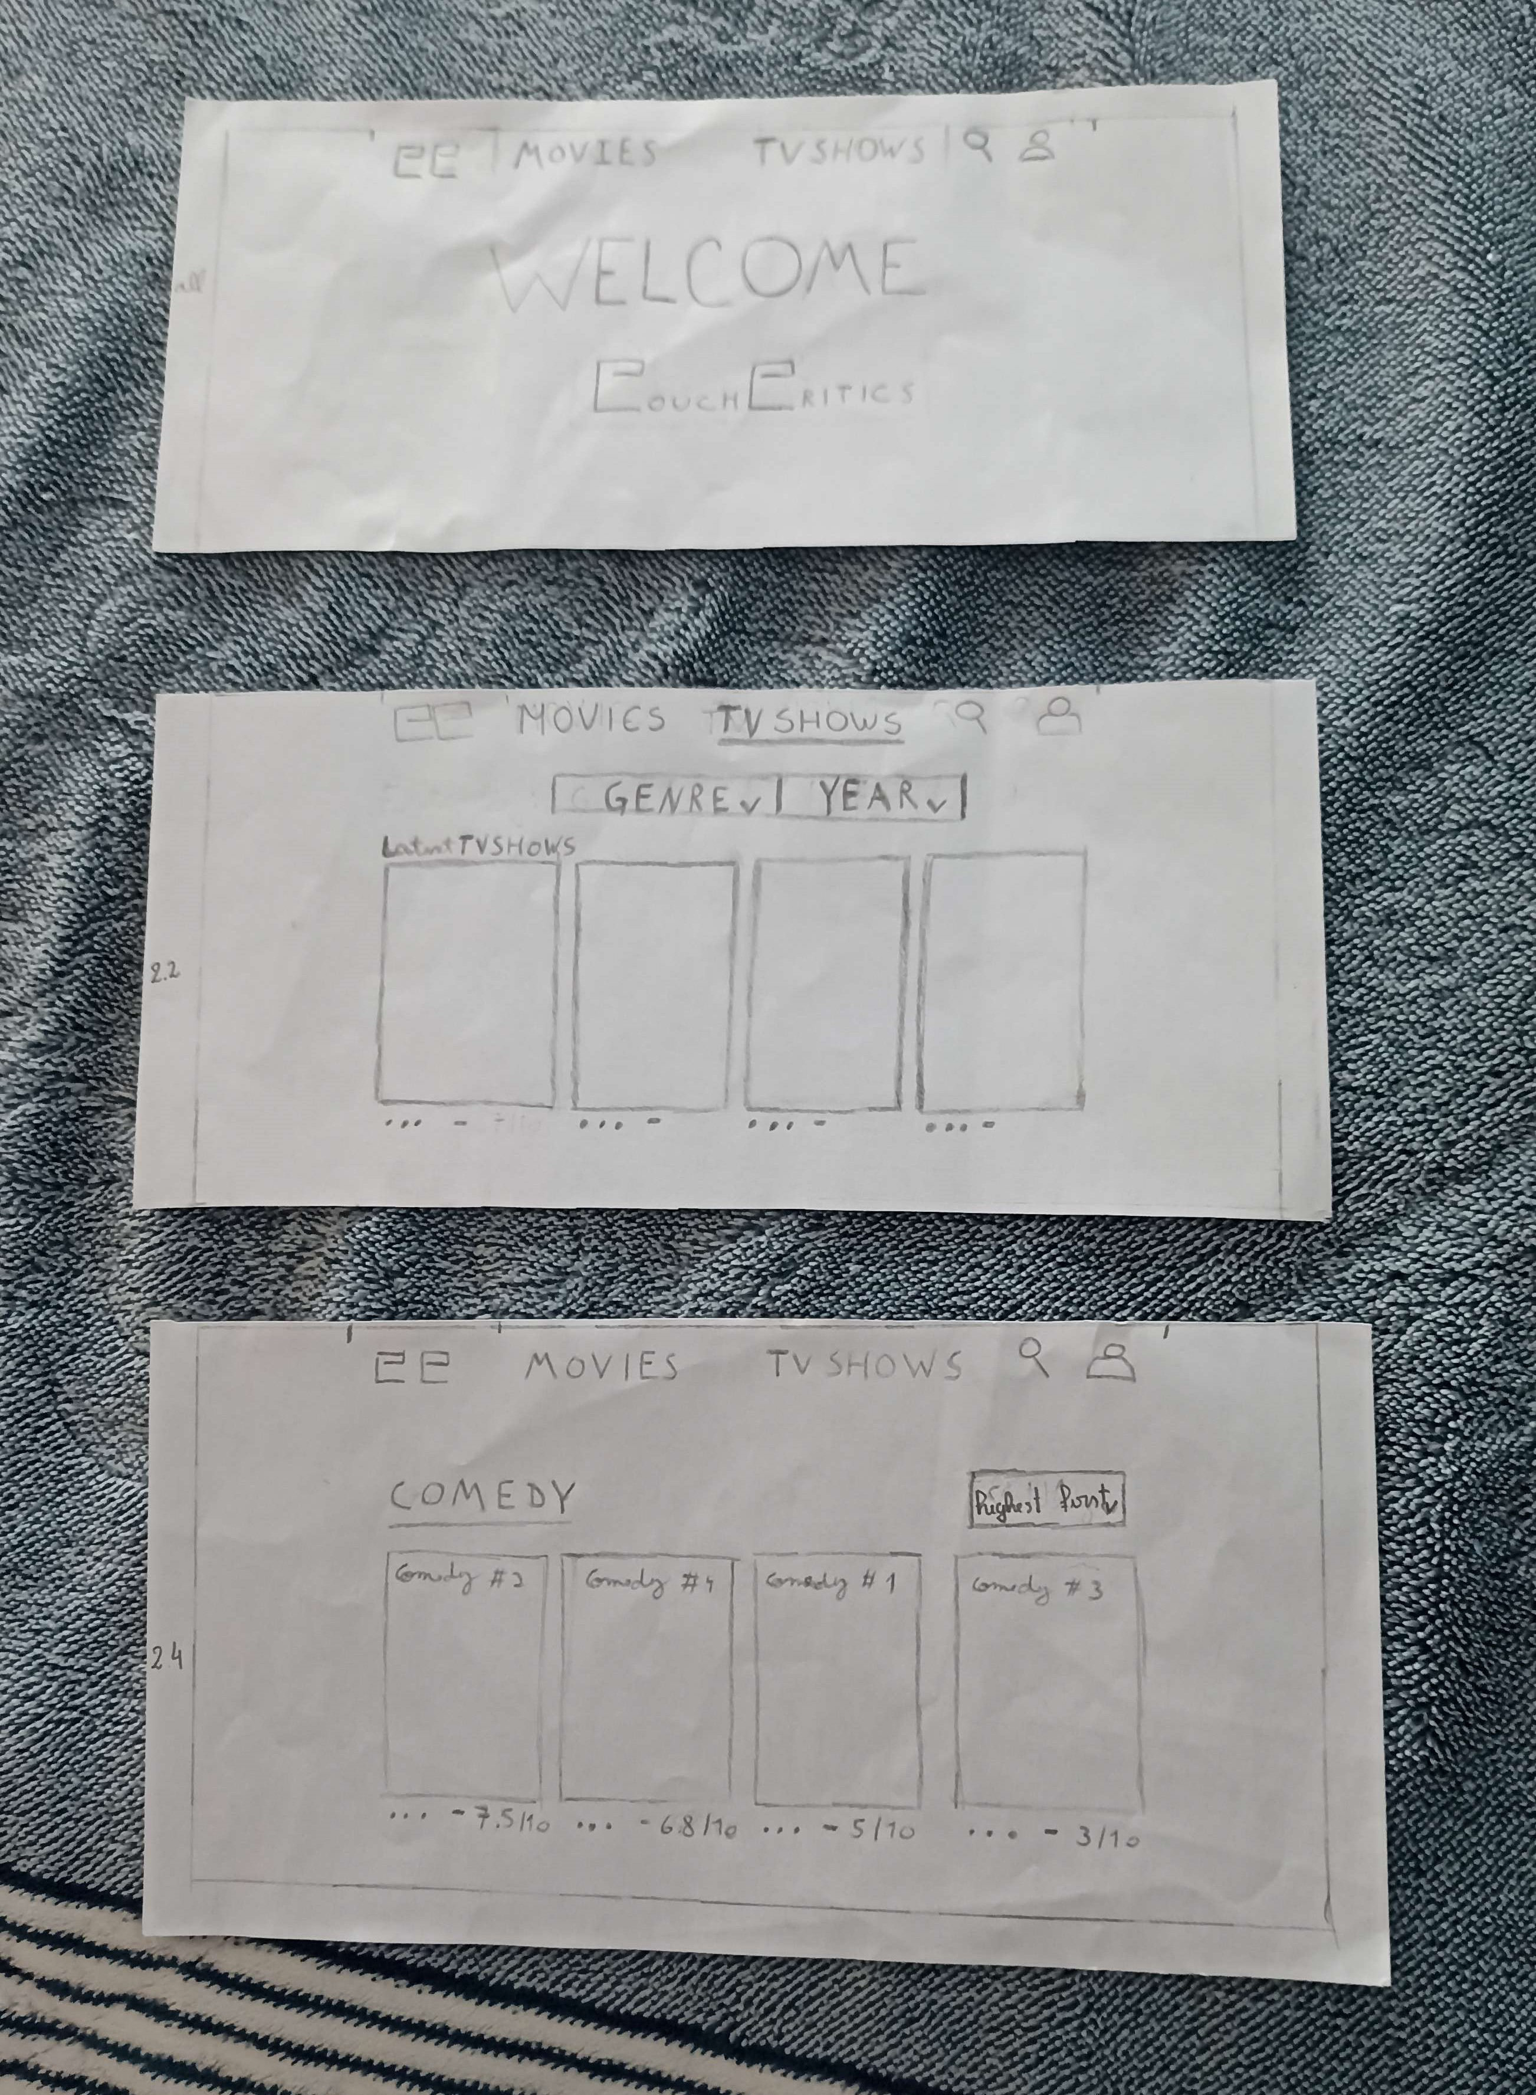
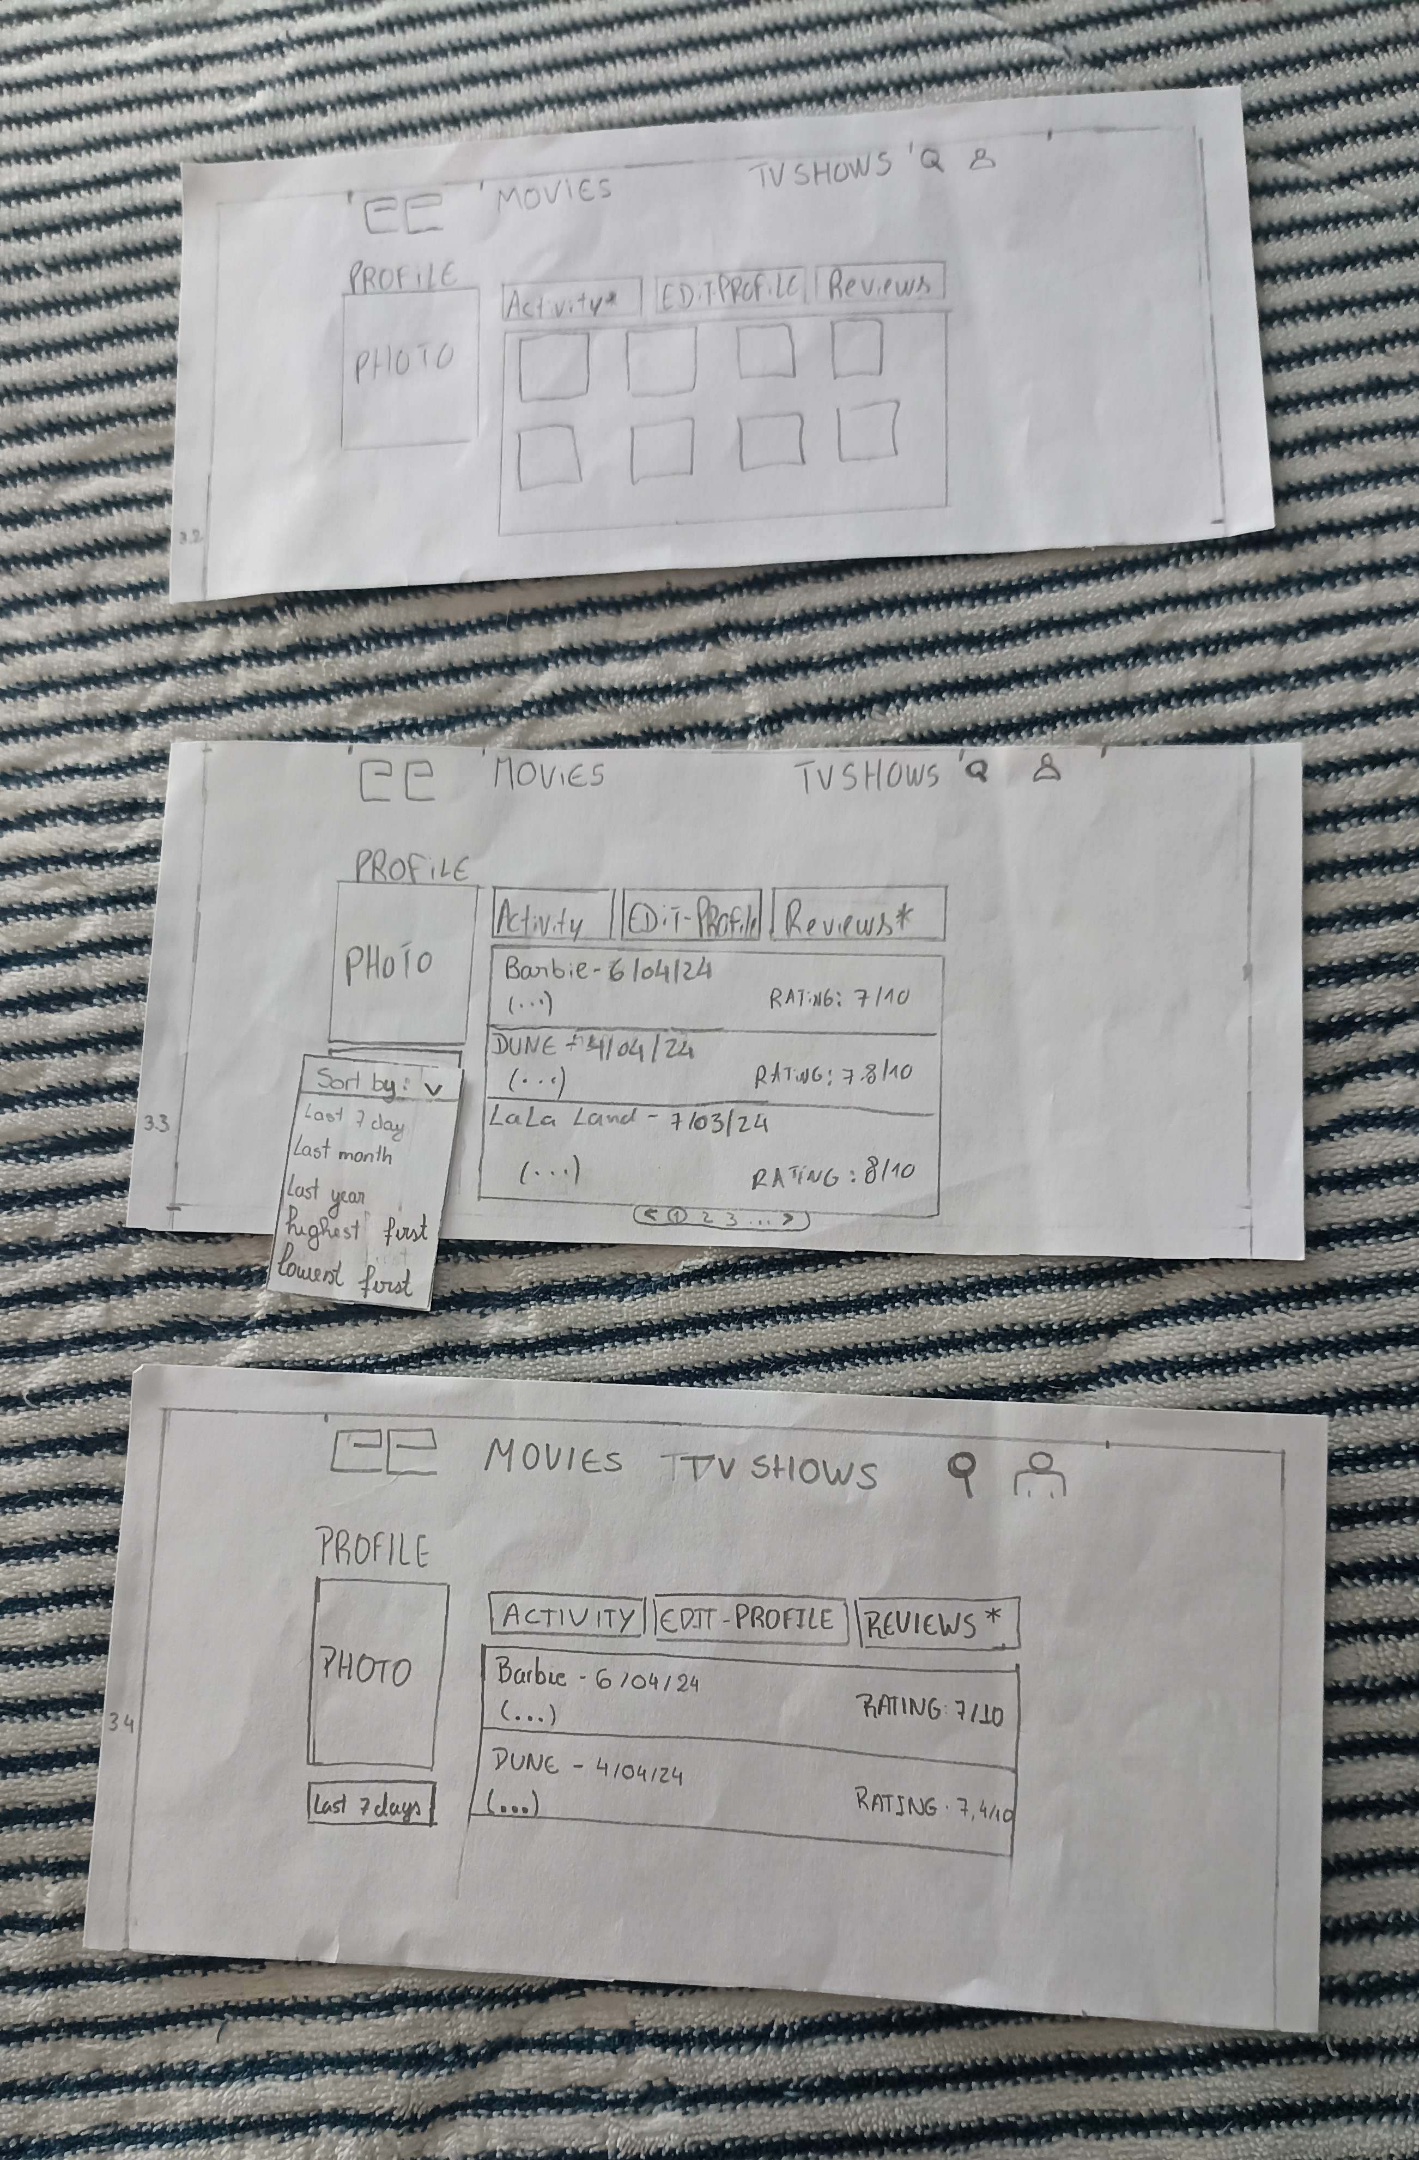
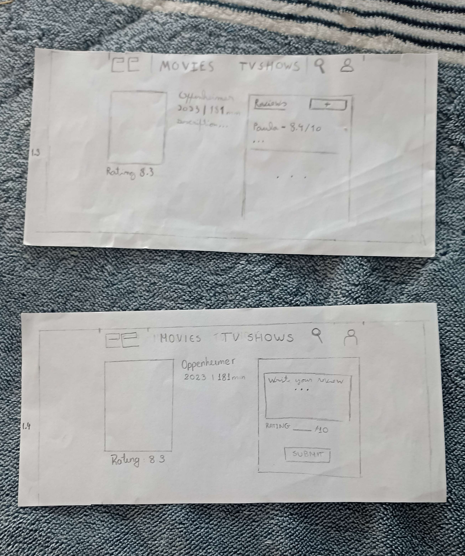
Low Fidelity Prototype
Creation of a paper prototype to test the main tasks with real people.

Slide 17
Low Fidelity Prototype User Evaluation
Aimed to evaluate the system’s intention, design and occurrence of errors.
Using the previous 3 tasks defined
6 participants were submitted to the test

Slide 18
LFP – User Evaluation - Results
Main page title “Couch Critics” shouldn’t be design as a button
Profile page had some problems with the reviews and sort buttons
Profile needed some redesign

Slide 19
05
Functional Prototype

Slide 20



Technologies
React
Next.Js
PocketBase
React.js is a javaScript library that allows us to create UI components
Resulting in a more dynamic and responsive user experience
Next.Js is a React framework that enhances our application with a server-side rendering and static site generation
PocketBase is an open-source backend that provides a real time database, authentication and file storage

Slide 21
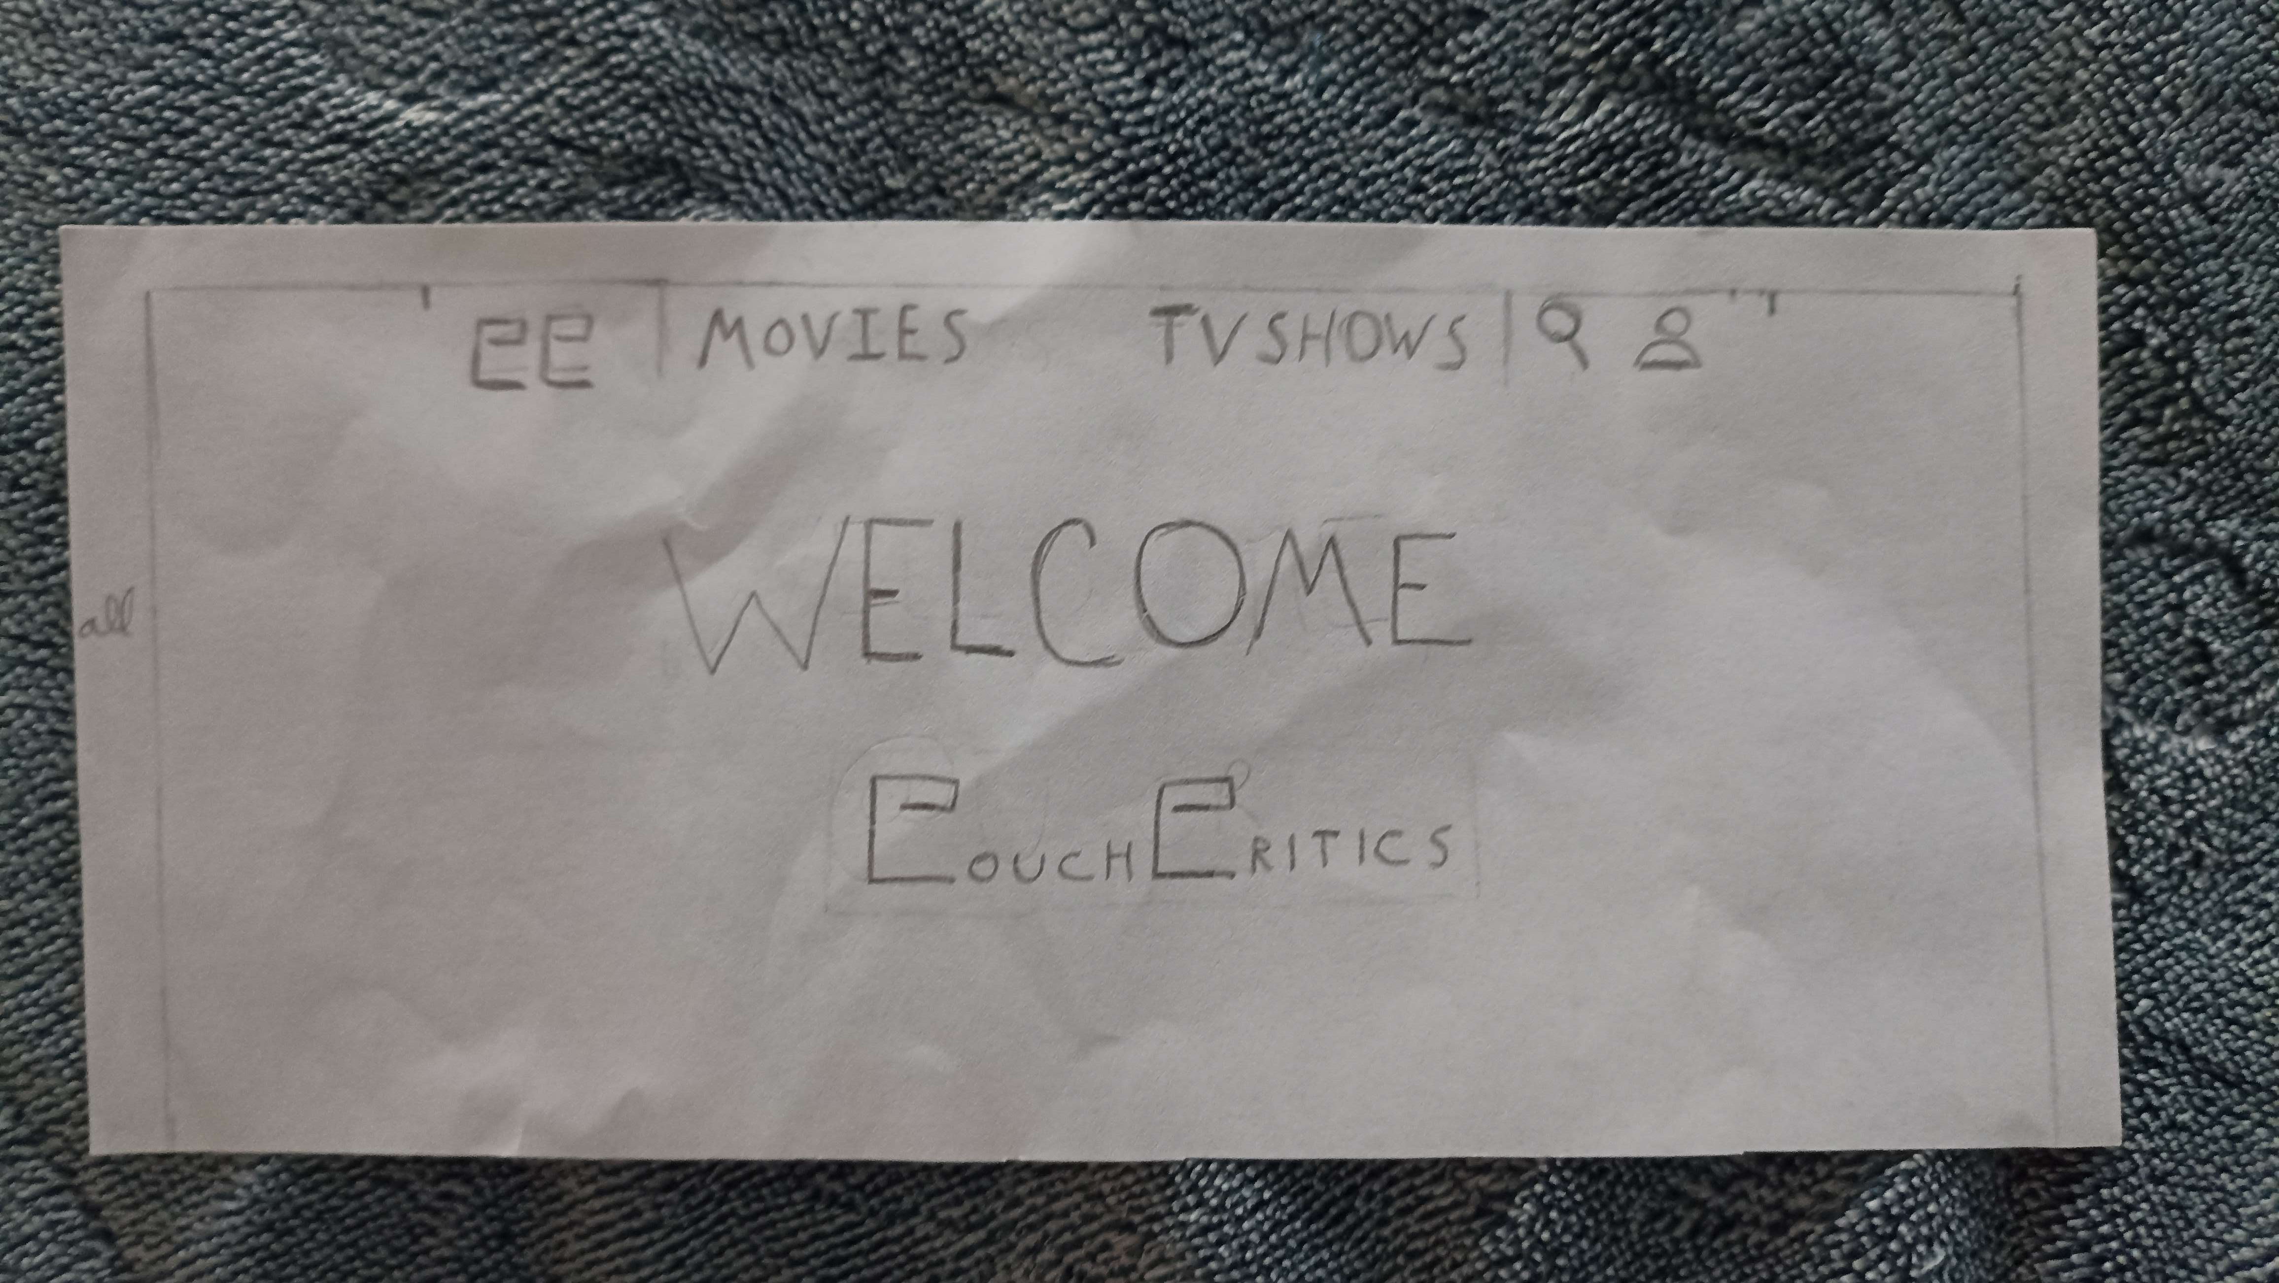
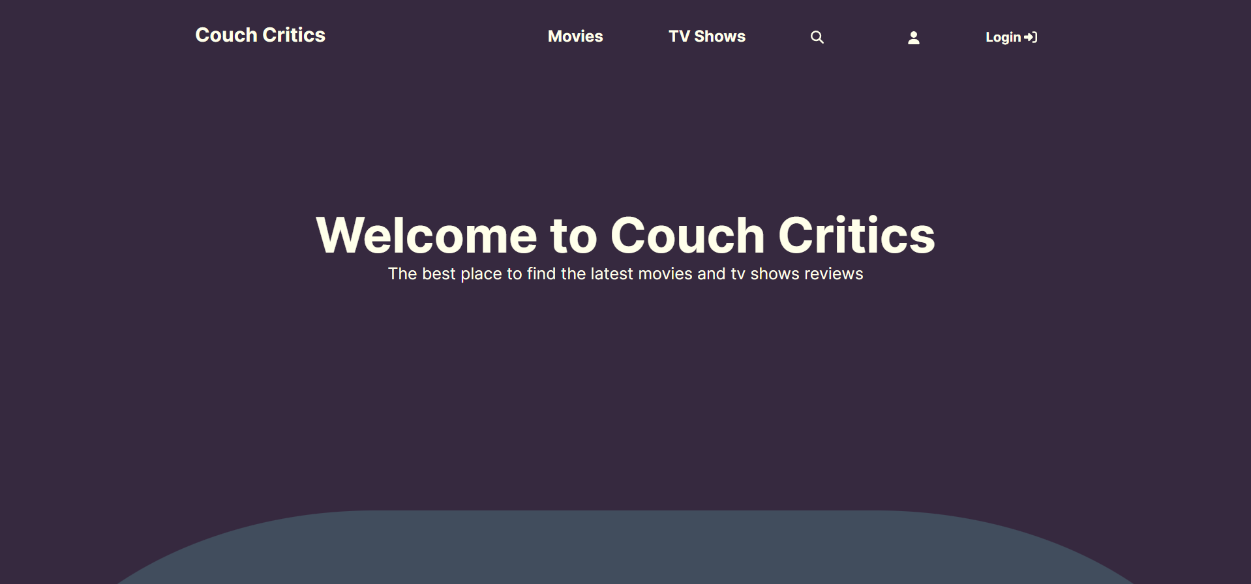
Changes from the paper prototype to the functional
This were made during the development of the functional prototype;
Users were trying to click the non-clickable "CouchCritics" in the center, so we made changes to ensure our interface is more user-friendly.
Every page has the auth state, telling the user if he is logged in or not
Notes:
Falar do botao de filtrar as reviews no perfil no paper prototype era últimos 7dias na aplicação é oldest review

Slide 22
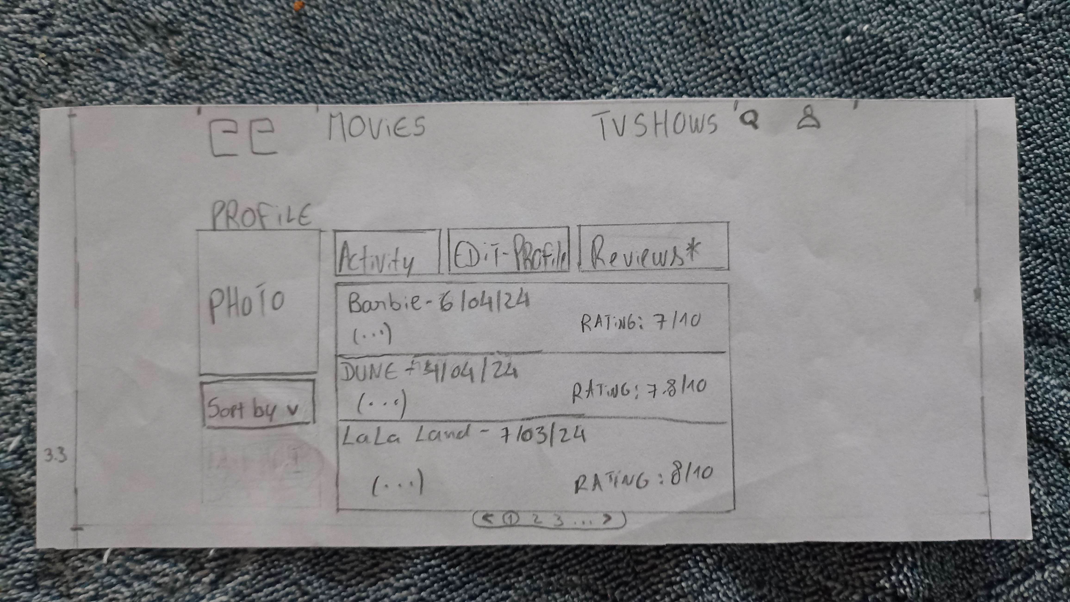
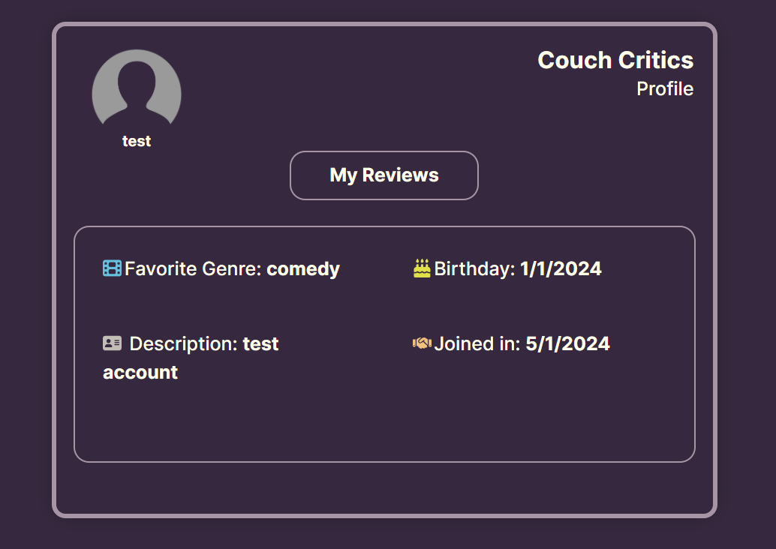
Changes from the paper prototype to the functional
We redesigned the profile to enhance objectivity and simplify user experience.
Reviews are separated from the main profile page, making it less overwhelming.
Notes:
Falar do botao de filtrar as reviews no perfil no paper prototype era últimos 7dias na aplicação é oldest review

Slide 23
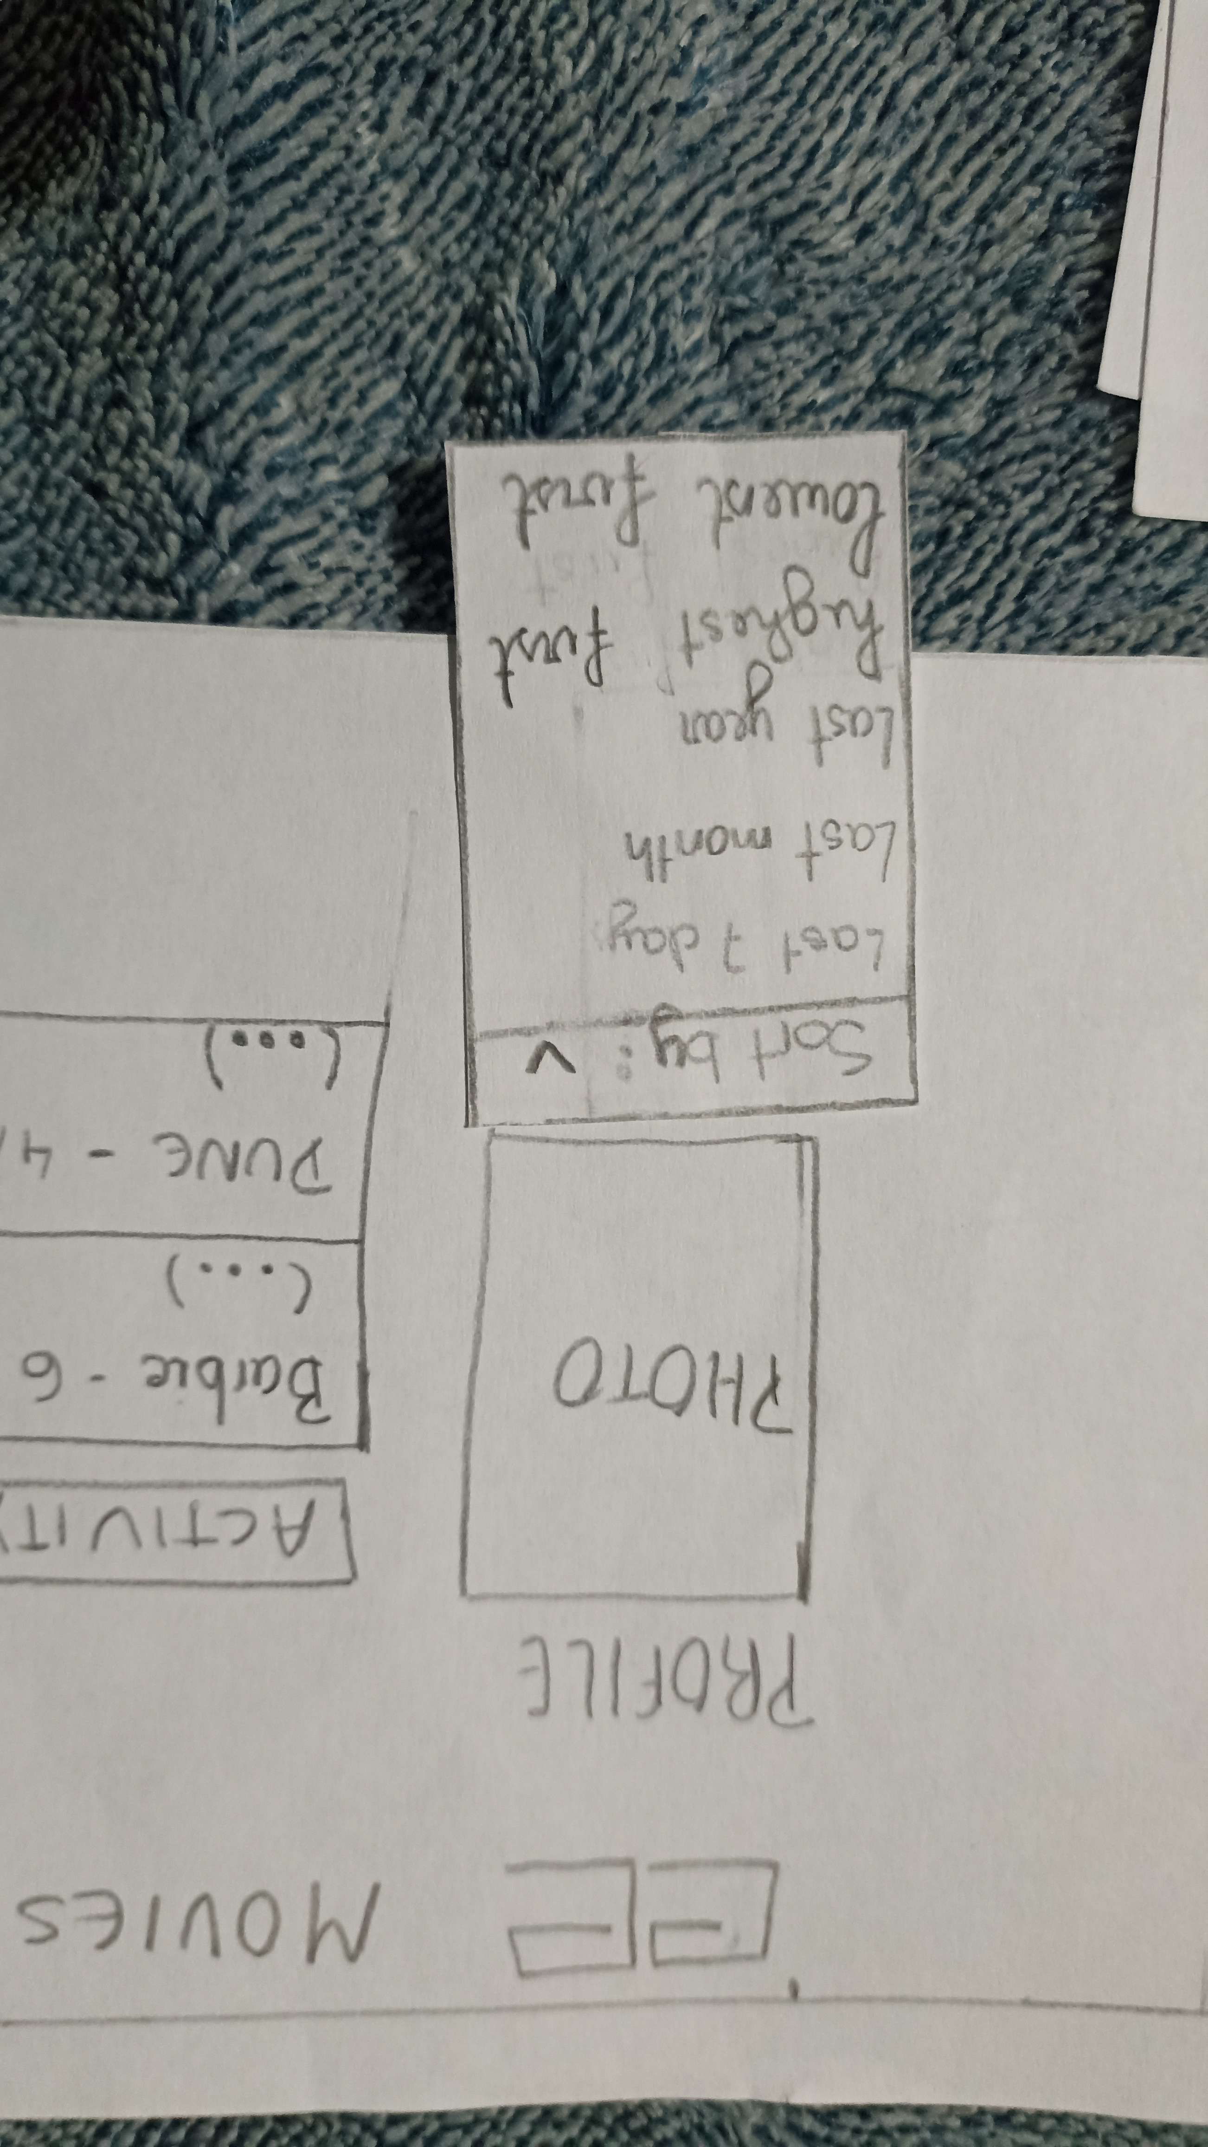
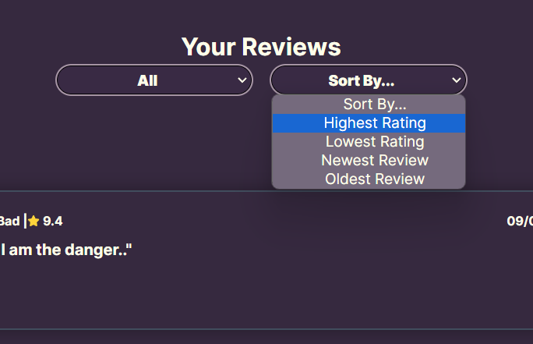
Changes from the paper prototype to the functional
We opted to sort reviews by newest and oldest rather than by the last 7 days or the last year to ensure that is more useful to the user.
Notes:
Falar do botao de filtrar as reviews no perfil no paper prototype era últimos 7dias na aplicação é oldest review

Slide 24
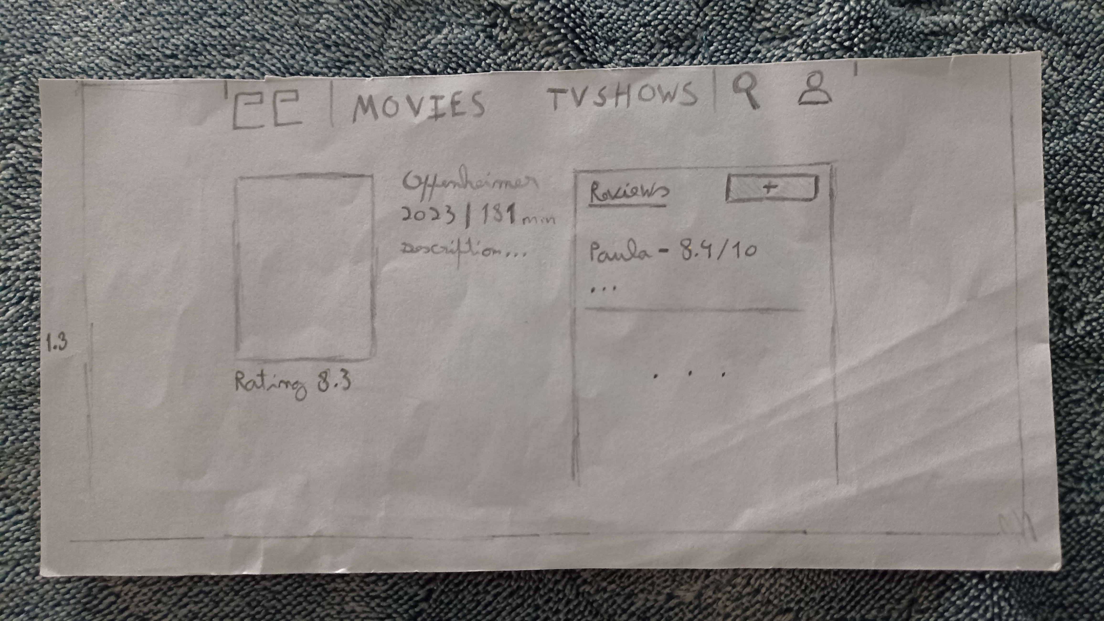
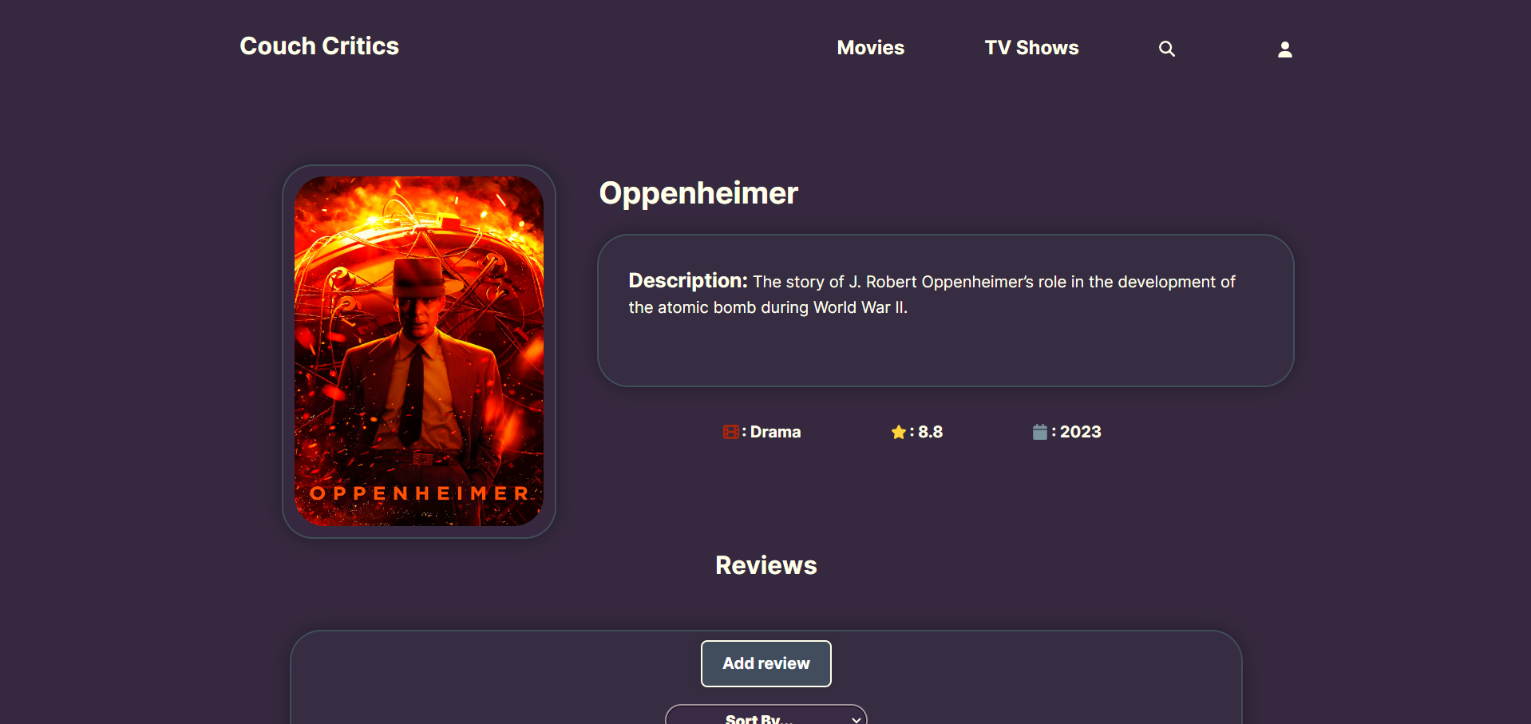
Changes from the paper prototype to the functional
Changed the reviews division in the individual pages for better spacing.
Notes:
Falar do botao de filtrar as reviews no perfil no paper prototype era últimos 7dias na aplicação é oldest review

Slide 25
Functional prototype - Results
 | User 1 | User 2 | User 3 | User 4 | User 5 | Average
Task 1 | 5 | 4 | 5 | 5 | 5 | 5
Task 2 | 5 | 4 | 5 | 5 | 5 | 5
Task 3 | 5 | 5 | 5 | 5 | 4 | 5

Slide 26
Sus(System Usability Scale) - Results
X | User 1 | User 2 | User 3 | User 4 | User 5 | Average sus score
Sus score | 97.5 | 100.0 | 95.0 | 97.5 | 100.0 | 98

Slide 27
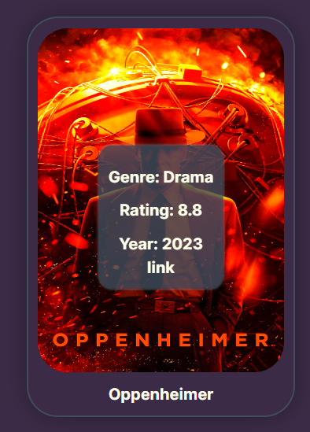
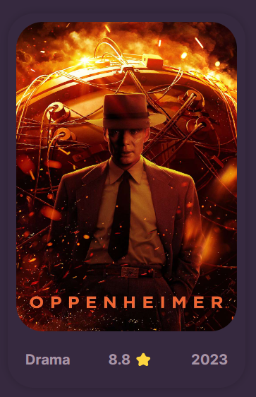

Changes after the users feedback
-Change on the display of information for each movie/tvshow

Slide 28
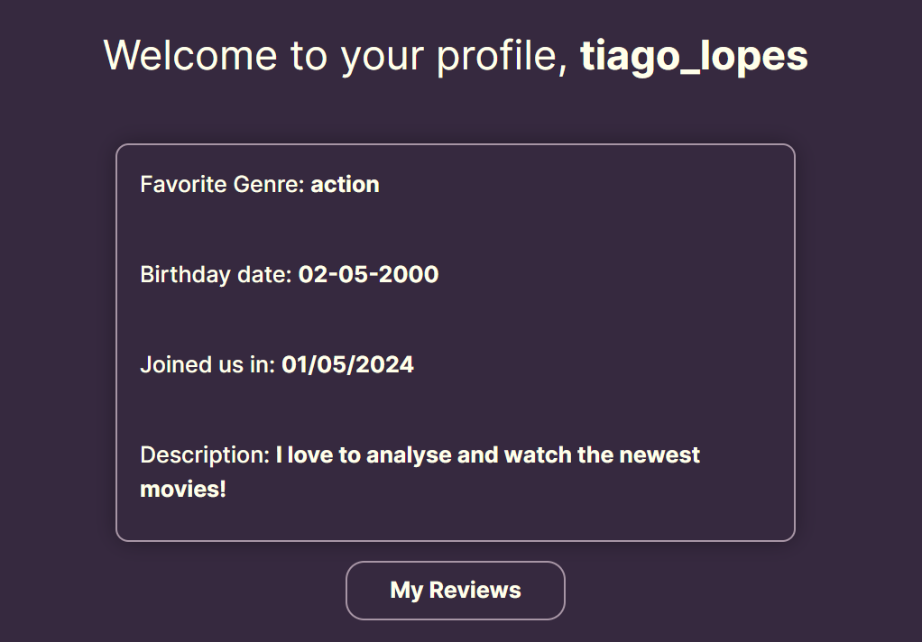
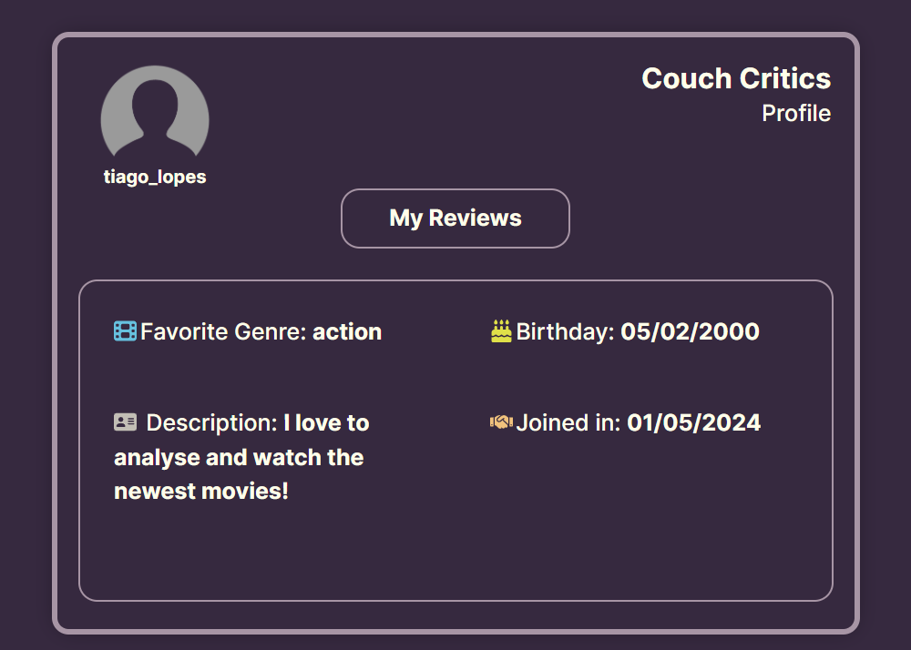
Changes after the users feedback

Slide 29
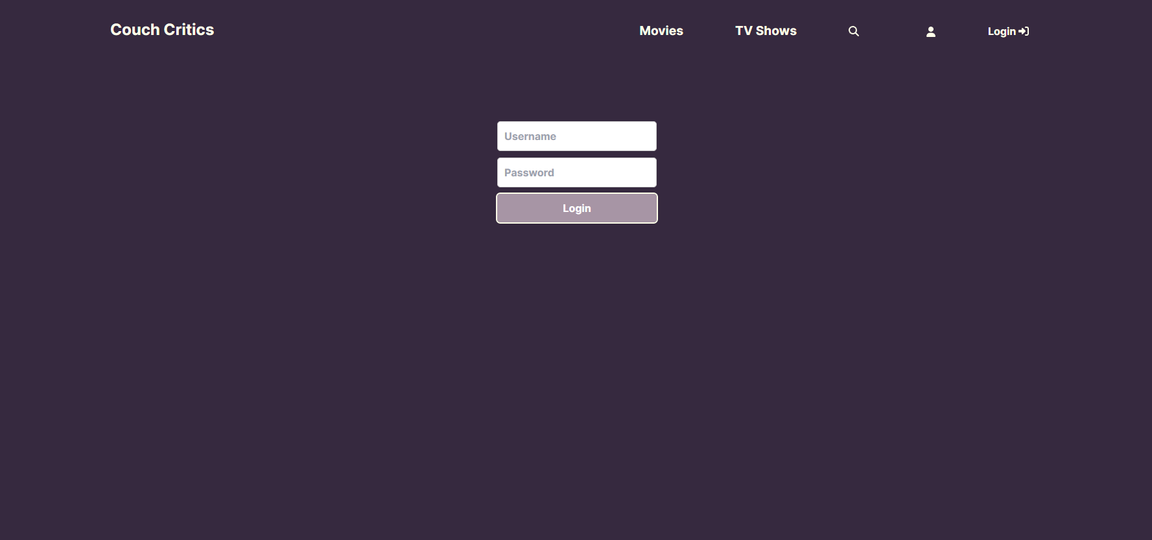
Heuristic evaluation
The user doesn’t have a “Change password” or “Forgot my password” button. User control and freedom – SV3

Slide 30
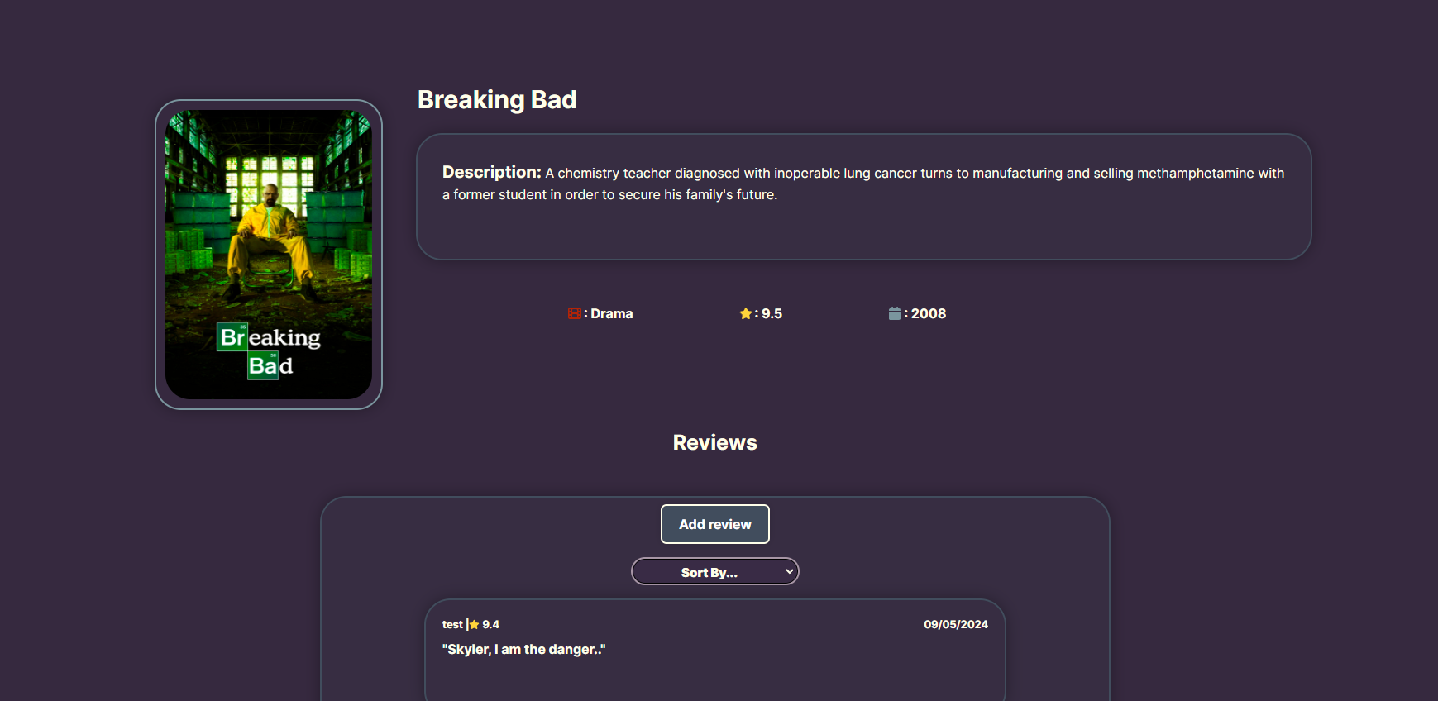
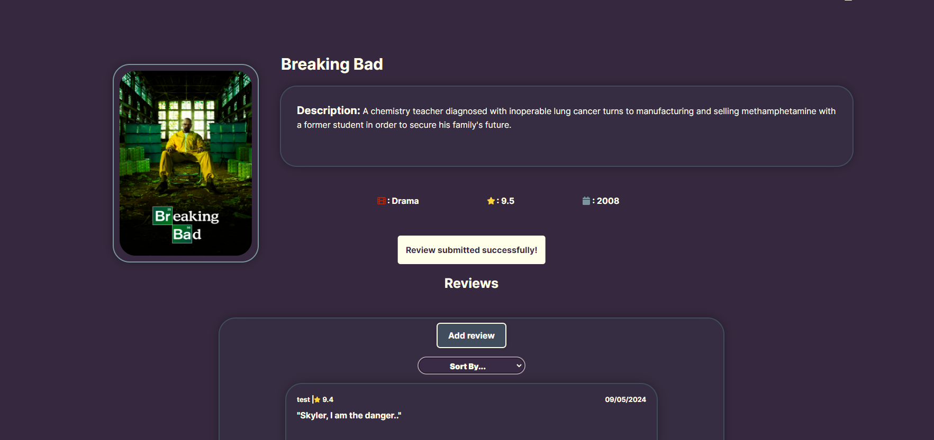
Heuristic evaluation
When a user submits a review, it should appear prominently in their view. However, if the movie or TV show already has several reviews, the user's review gets pushed down, making it difficult for them to see it immediately.
Visibility of system status – SV1

Slide 31
DEMO
Sit back and enjoy this one

Slide 32
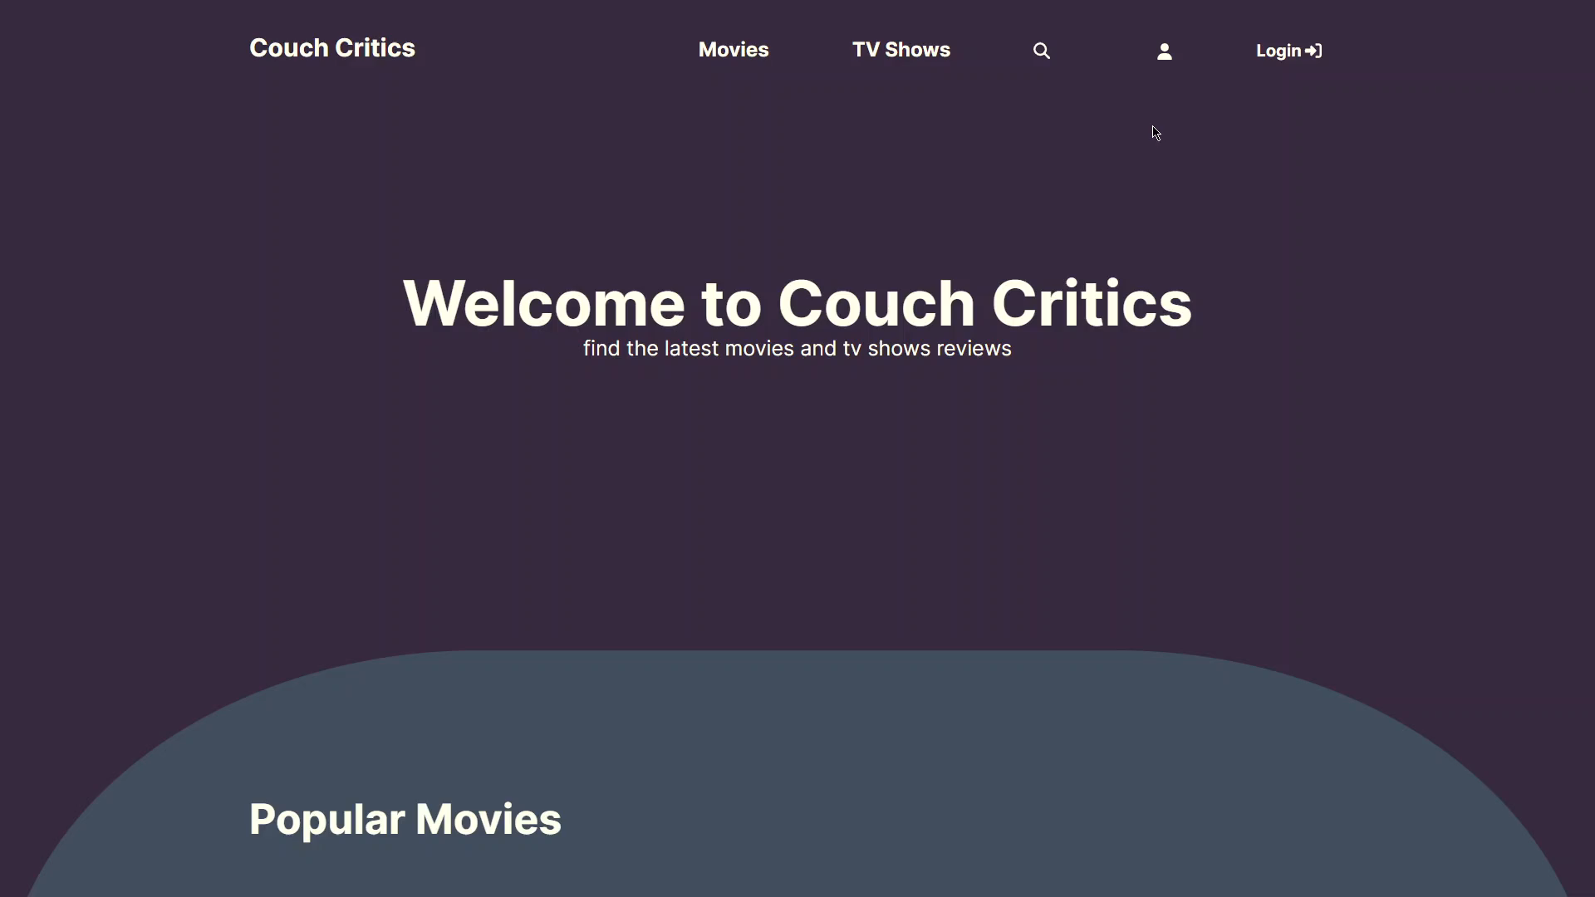
DEMO
Sit back and enjoy this one

Slide 33
06
Conclusion

Slide 34
Final Thoughts
The low fidelity prototype brought us the first type of outside feedback outside of the team, which was very important to make us widen our vision and thoughts about the whole platform.
The Tools we used were easy to comprehend and were well suited for what they were assigned to do.
The functional prototype gave us more data as feedback with the SUS( System Usability Scale) but also the normal user feedback along with providing the experience of using the website for the first time for the users.

Slide 35

Percentage of Work
Adriano Costa – 1/3
Guilherme Santos – 1/3
Nuno Pinho – 1/3

Slide 36
Future Work
Allow users to edit their own reviews;
Add a social component to the platform, friends, etc…
Create a register form to let users create their own accounts (right now just through database)
See where the movies/Tvshows are available for streaming

Slide 37
THANKS! Any Questions?

